Slide 1

Advisory Committee for Federally Funded Programs
Division of Educational Services
September 22, 2023
Notes:
Diana
Hello Everyone and welcome to the Maximizing Federal Funds Webinar!
We are excited to know who is in our group so please put your name and where you are coming from in the chat!
pause
Today we will be introducing a resource developed in collaboration across the NJ Department of Education and the Region 4 Comprehensive Center Network,.
Next Slide

Slide 2
AGENDA
Advisory Committee for Federally Funded Programs
TEAMS Chat Box Monitor | Mr. Clark Coe, Project Specialist Office of the Executive Director/Deputy Assistant Commissioner Division of Educational Services
Moderator’s Welcome | Dr. A. Charles Wright, Executive Director/Deputy Assistant Commissioner Division of Educational Services
Greetings Acknowledgement of the Passing of Andrea Sunderville | Ms. Kathy Ehling, Assistant Commissioner Division of Educational Services Dr. A. Charles Wright, Executive Director/Deputy Assistant commissioner Division of Educational Servicews
Review of May 19, 2023, ACFFP Meeting Highlights Committee Overview | Dr. A. Charles Wright, Executive Director/Deputy Assistant Commissioner Division of Educational Services Dr. A. Charles Wright, Executive director/Deputy Assistant Commissioner Division of Educational Services
Federal Updates Office of Strategic Operations ESSA State Plan Public comments | Ms. Aida Epifanio, Federal Liaison Office of Strategic Operation Ms. Diana Pasculli, Executive director Mr. John Iko, Planning Associate/Data Analysis Division of Educational Services
 | .
NEXT MEETING Friday, January 26, 2023

Slide 3
Call To Order
Dr. A. Charles Wright,
Executive Director/Deputy Assistant Commissioner
Division of Educational Services
Notes:
Kathy

Slide 4
Greetings
Ms. Kathy Ehling
Assistant Commissioner
Division of Educational Services
Notes:
Kathy

Slide 5
Acknowledgement of the Passing of
Andrea Sunderville
Dr. A. Charles Wright,
Executive Director/Deputy Assistant Commissioner
Division of Educational Services
Notes:
Kathy

Slide 6




Slide 7
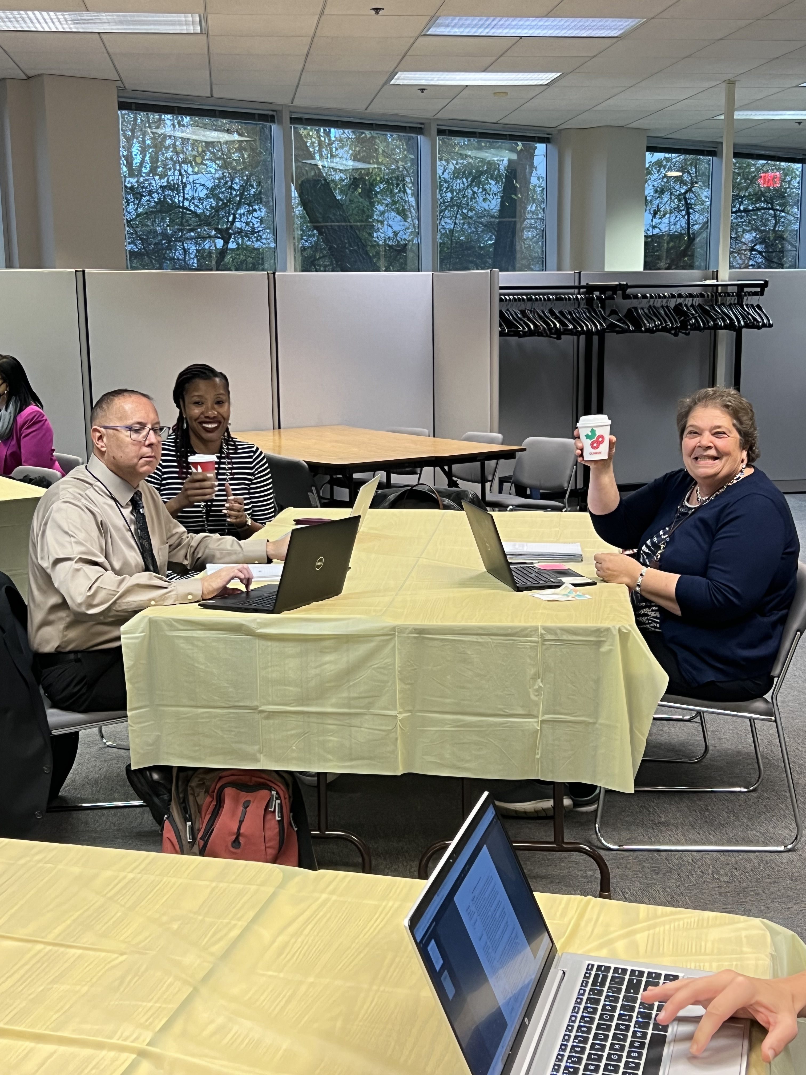
Good
Ideas
Start
With
Brainstorming…..
Great Ideas Start With Coffee
Any Friend of Coffee is a Friend of Mine

Slide 8


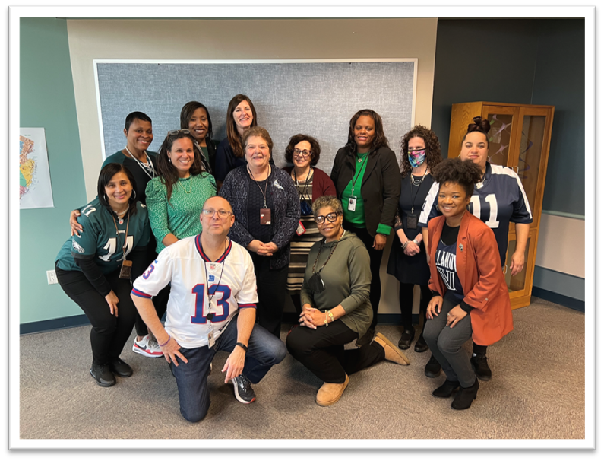

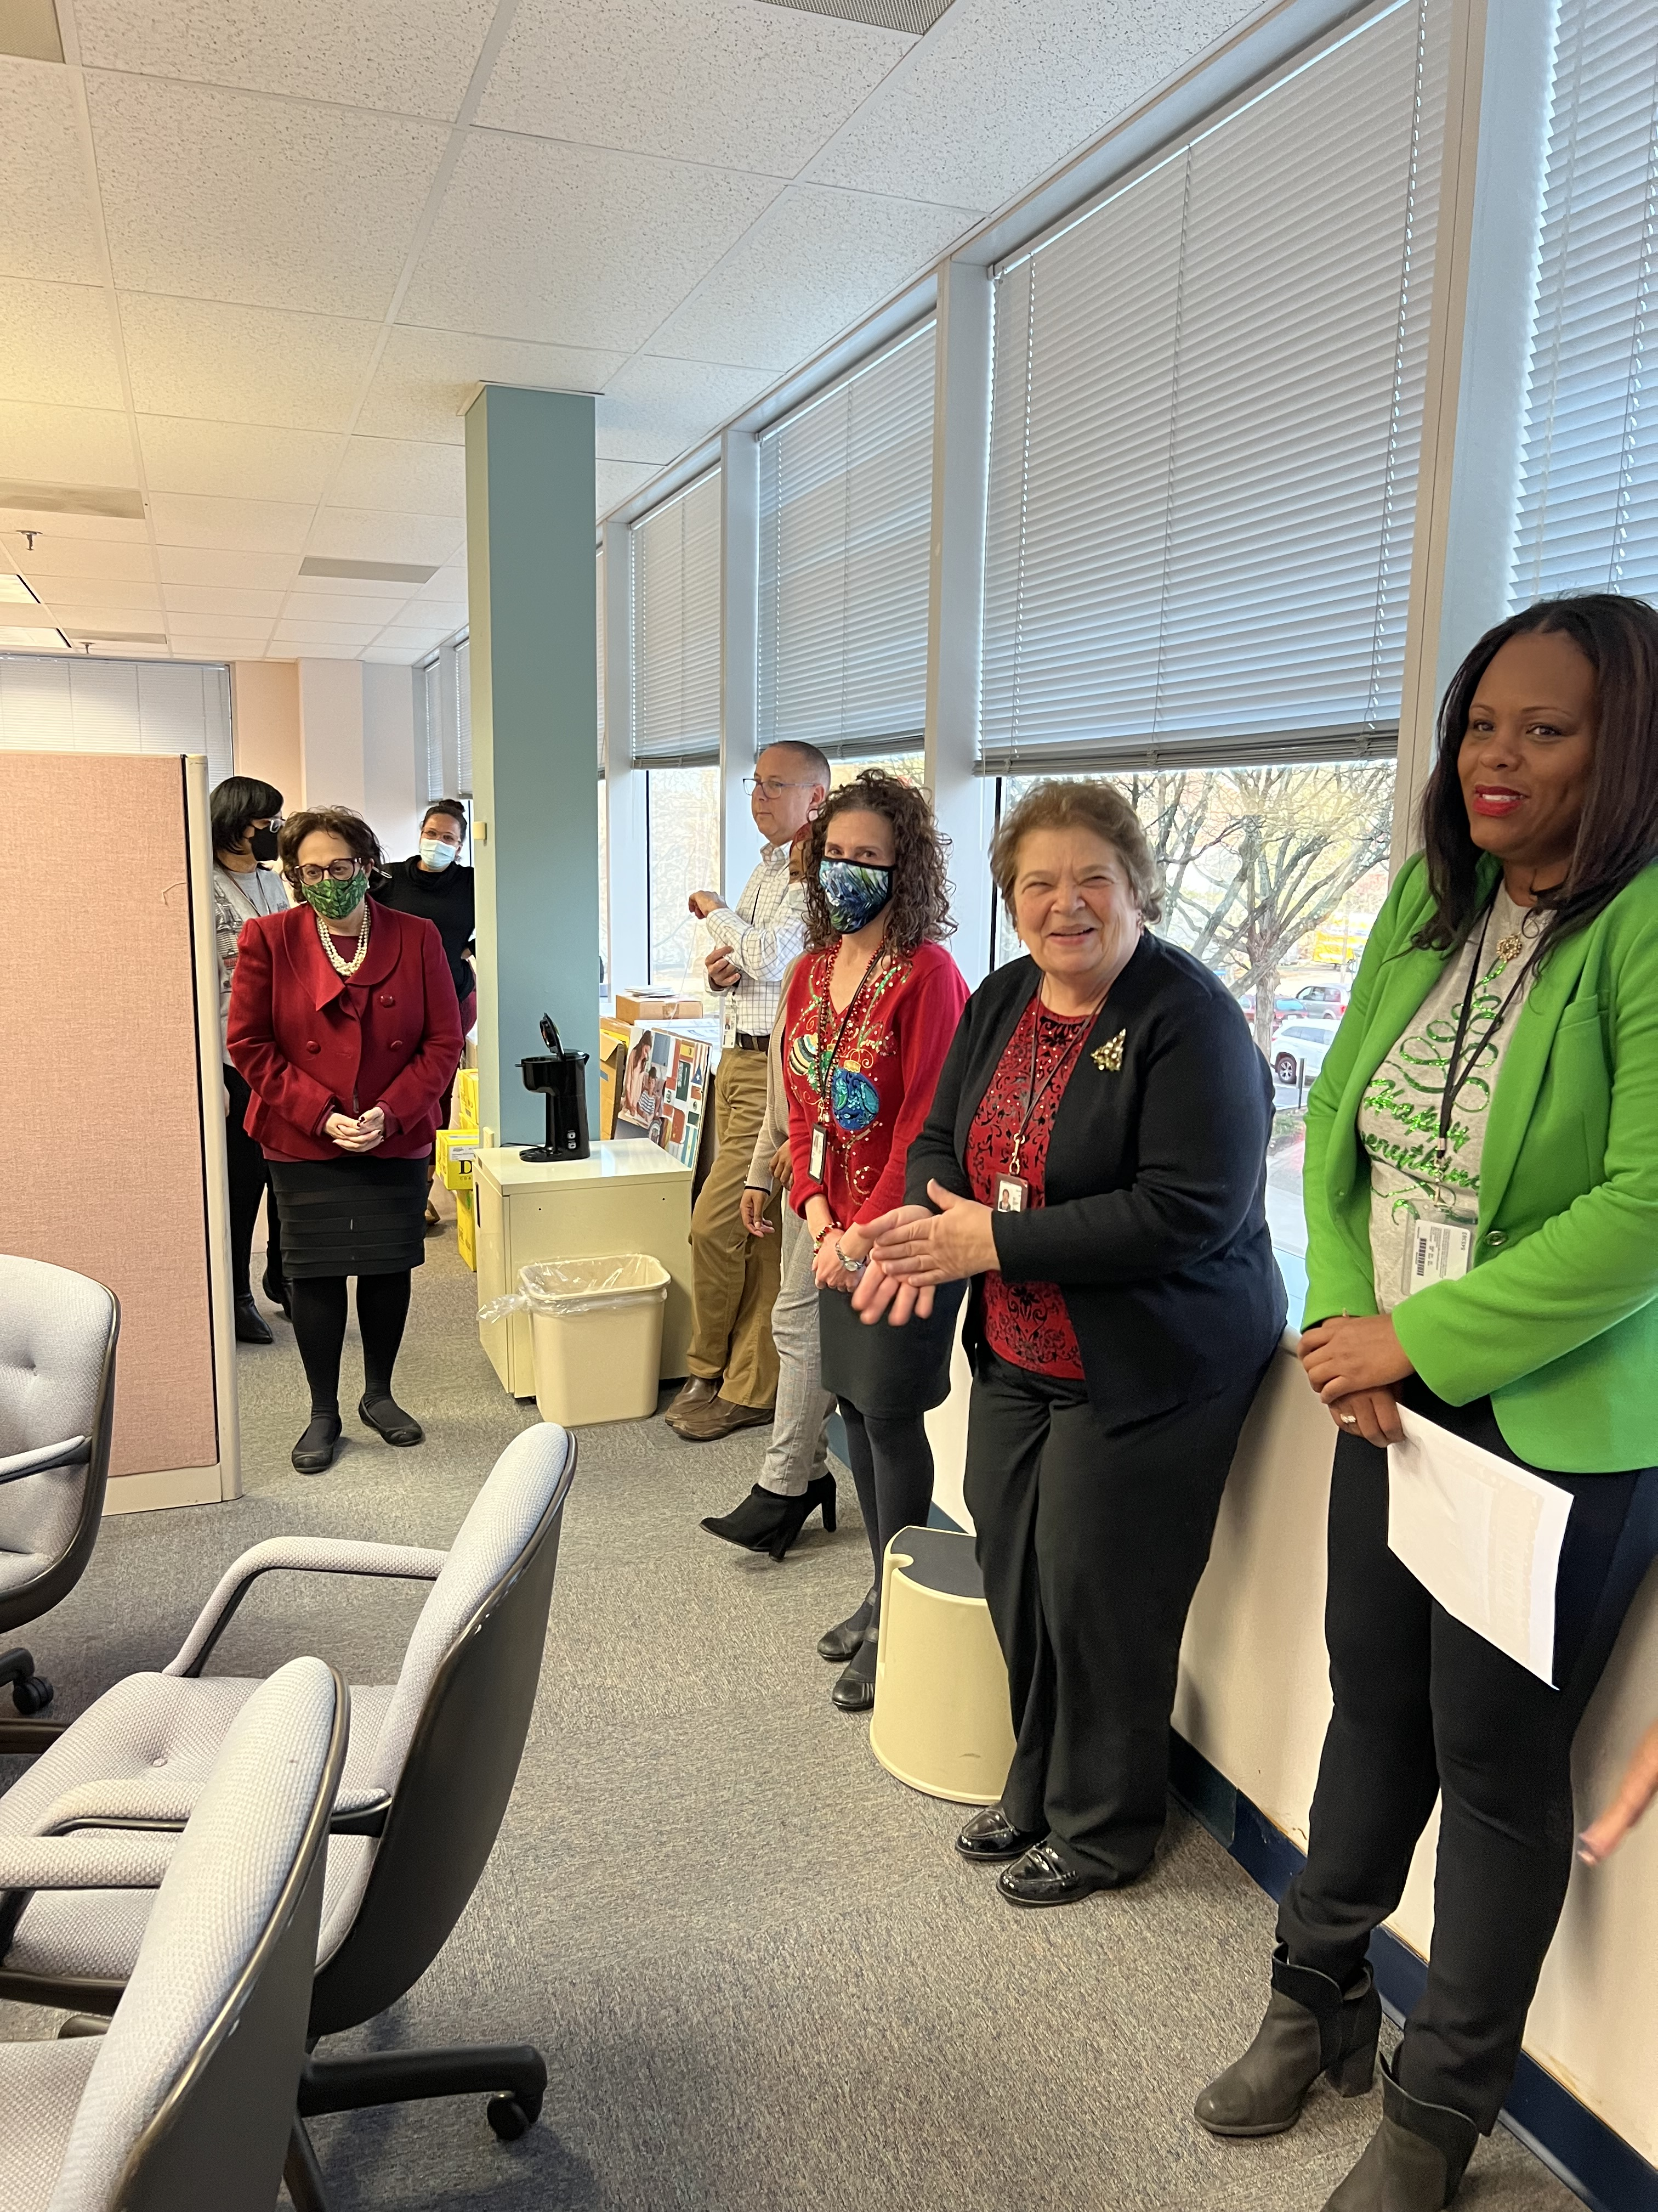
Forever in Our Hearts
Office of Supplemental Educational Programs
with the 2023 Teacher of the Year

Slide 9
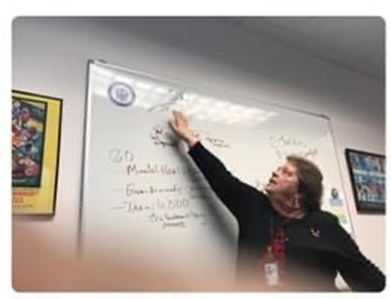
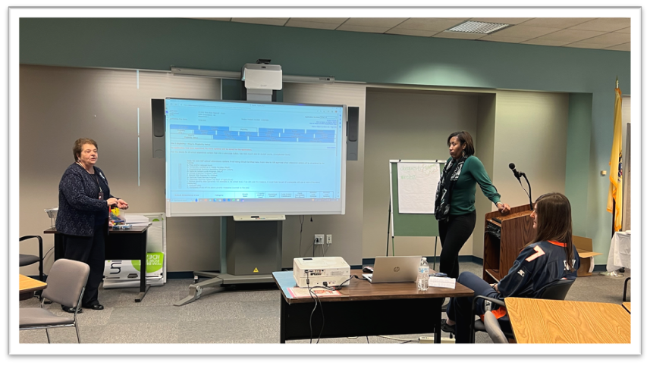
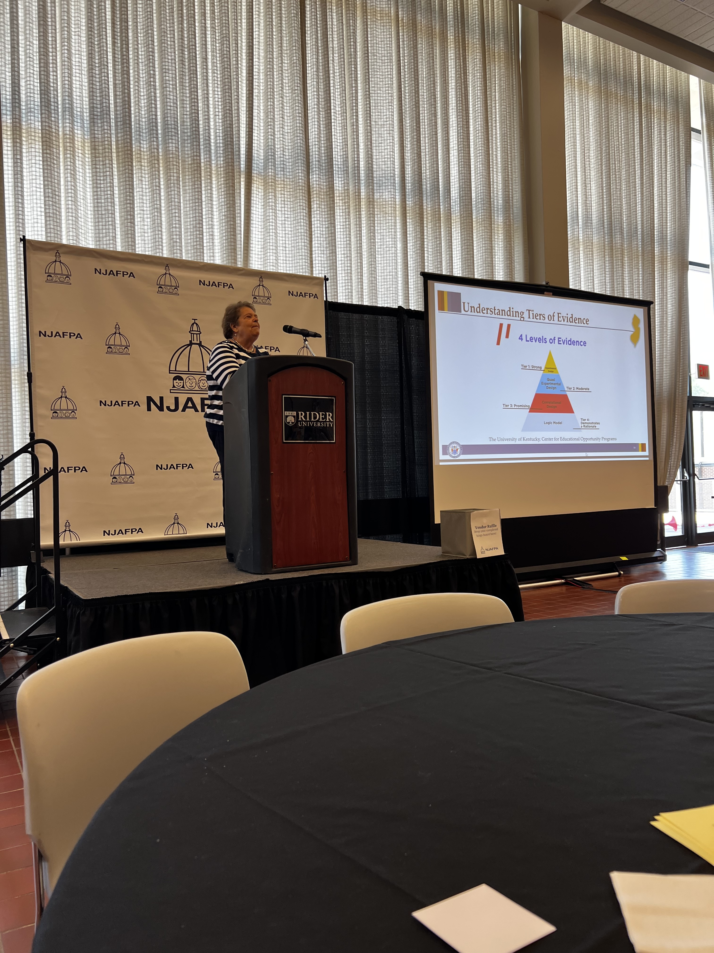
Just like M&M’s,
every student has their own unique talents and abilities.

Slide 10


Motivating & Meaningful
Teaching is like M&M’s – it’s the little things that make all the difference.
M&M’s are a reminder that the little things we do can have a big impact on our students.
Teaching is like a bag of M&M’s – it’s important to share and collaborate with others.
M&Ms remind us that life is full of colorful moments. Embrace them all.
Just like M&Ms, we are all unique and special in our own way.
Sometimes it’s the smallest things, like a single M&M, that can bring the most joy.

Slide 12
Review of ACFFP Meeting Highlights
May 19, 2023
Dr. A. Charles Wright,
Executive Director/Deputy Assistant Commissioner
Division of Educational Services
Notes:
Kathy

Slide 13
Ad Hoc Committee Review
Dr. A. Charles Wright,
Executive Director/Deputy Assistant Commissioner
Division of Educational Services
Notes:
Kathy

Slide 14
Federal Update
Federal Update
Ms. Aida Epifanio, Federal Liaison
Office of Strategic Operations

Slide 15

Agenda
Reminder: ESSER funds expenditures
Fiscal Sustainability Resources
Highlighting Raise the Bar efforts in NJ
National K–12 Supports

Slide 16
ESSER Reminders
ESSER funds (CARES, CRRSA, ARP): additional funding to support local educational agencies (LEAs) in preparing for and responding to the impact of COVID-19 on educators, students, and families.
  September 2023: deadline to obligate all ESSER II funds.
  September 2024: deadline to obligate ARP ESSER funds.
Allowable uses, accounting guidance and other resources: https://www.nj.gov/education/esser/resources/
Maximizing Federal Funds: https://www.nj.gov/education/federalfunding/index.shtml
NJDOE Federal Funding Dashboard (updated twice a month)

Slide 17
USED Fiscal Sustainability Resources
NJDOE recently received a Dear Colleague Letter (DCL) from USED addressing the importance of fiscal sustainability beyond pandemic relief efforts
The DCL highlighted how Title I, IDEA, and other formula and grant funds can help sustain pandemic relief investments
NJDOE is currently in the process of reviewing these resources and additional guidance on fiscal sustainability will be forthcoming

Slide 18
Raise the Bar in NJ
Raise the Bar: Lead the World: USED’s vision and priorities for 2023
One of the key priorities is Boldly Improving Learning Conditions, which asserts that every student should have access to outstanding, well-prepared, well-supported educators who reflect the diversity of the students they serve.
NJ is deeply invested in supporting this effort and will be co-sponsoring the 2023 Diversifying the Teacher Workforce Convening in October.
Notes:
“Raise the Bar: Lead the World” lays out the US Department of Education’s vision and priorities for 2023
Link to USED’s Raise the Bar website: https://www.ed.gov/raisethebar/
One of the key priorities is Boldly Improving Learning Conditions, which includes eliminating the educator shortage for every school and ensuring that all students should have the opportunity to be taught by diverse educators.
Link to Boldly Improving Learning Conditions: https://www.ed.gov/raisethebar/educators

Slide 19

NJ’s 2023 National Blue Ribbon Schools
Basking Ridge – Oak Street School, Bernards Township Board of Education.
Colonia – Claremont Avenue Elementary School, Woodbridge Township School District.
Demarest – Luther Lee Emerson School, Demarest School District.
Garfield – Washington Irving School No 4, Garfield City School District.
Haddonfield – J Fithian Tatem Elementary School, Haddonfield Public Schools.
Lincroft – High Technology High School, Monmouth County Vocational School District.
Mendham – Hilltop Elementary School, Mendham Borough School District.
Newark – Technology High School, Newark Board of Education.
Princeton – Princeton Charter School, Princeton Charter School.
Notes:
The U.S. Department of Education today recognized 353 schools as National Blue Ribbon Schools for 2023, including nine schools in New Jersey. The recognition is based on a school’s overall academic performance or progress in closing achievement gaps among student subgroups on assessments.

Slide 20
SY 22-23 National K-12 Supports
SchoolSafety.gov: USED, DHS, and DOJ recently launched a public awareness campaign to highlight federal school safety resources and evidence-based practices available to support safer schools and communities.
National Center on Safe Supportive Learning Environments (NCSSLE): hosts webinars, conferences, and learning events on a wide variety of topics related to improving conditions for learning.
Overdeck Family Foundation Family Engagement Learning Series: recently released Strategies and Resources to Support Effective Family Engagement.
Engage Every Student Initiative: helps communities use ARP funds, alongside other state and local funds, to provide high-quality out-of-school time learning opportunities for every child who wants to participate.
National Partnership for Student Success: aims to recruit 250,000 new tutors, coaches, and mentors to ensure students have what they need to thrive. Recently issued Year in Review. NJDOE has launched a counterpart effort, the New Jersey Partnership for Student Success.
Notes:
SchoolSafety.gov:
The Back-to-School Campaign encourages members of the K-12 community to visit SchoolSafety.gov and use its resources and tools to create safe and supportive learning environments for students and educators. Campaign information and materials will be accessible through a dedicated hub on SchoolSafety.gov throughout August and September.
Link: https://www.schoolsafety.gov/back-to-school-campaign?utm_content=&utm_medium=email&utm_name=&utm_source=govdelivery&utm_term=
National Center on Safe Supportive Learning Environments (NCSSLE):
Upcoming webinars include: Lessons from the Field Webinar - Supporting Newcomer Students and From Assessment to Action: Enhancing Organizational Well-Being in Schools
Link to website https://safesupportivelearning.ed.gov/events
Overdeck Family Foundation Family Engagement Learning Series:
Link to Strategies and Resources to Support Effective Family Engagement, which summarizes the six-month webinar series designed to boost family engagement practices: https://www.carnegie.org/our-work/article/strategies-and-resources-support-effective-family-engagement/?utm_content=&utm_medium=email&utm_name=&utm_source=govdelivery&utm_term=
Engage Every Student Initiative:
Link to sign up for Engage Every Student Initiative updates: https://engageeverystudent.org/stay-informed/
National Partnership for Student Success:
Link to NPSS: https://www.partnershipstudentsuccess.org/
Link to Year in Review: https://www.partnershipstudentsuccess.org/a-year-in-review-the-national-partnership-for-student-success/

Slide 21






New Jersey Department of Education
@NewJerseyDOE
@newjerseydoe
Thank You!
New Jersey Department of Education
New Jersey Department of Education
@newjerseydoe

Slide 22


Slide 23
ESSA Consolidated State Plan
(2017 ESSA State Plan)
Upcoming Revision Project
Ms. Diana Pasculli, Executive Director
Office of the Assistant Commissioner

Slide 24

Presentation Outline
Introduction and Updates (Diana Pasculli)
Culture of Support (Azan Waddell)
ESSA Accountability Proposals (John Iko)
Next Steps
Notes:
For today, we are providing

Slide 25

I. Background
Confidential/Deliberative
Notes:
We want to make sure we are in the correct lane. This is a little more theoretical and we frankly want to hear more from all of you about some wish lists...

Slide 26

Background: Federal Law
In 2015, The Elementary and Secondary Education Act (ESEA) of 1965 was reauthorized by the Every Student Succeeds Act (ESSA) (Replacing No Child Left Behind Act).
“The purpose of this title is to provide all children significant opportunity to receive a fair, equitable, and high-quality education, and to close educational performance* gaps.”
*original language refers to "achievement gap"
Notes:
NJDOE will shift to asset-based language as much as possib le

Slide 27
Background: New Jersey State Plan (State Plan)
The State Plan:
Was approved by United States Department of Education (USED) in 2017.
Describes New Jersey’s approach to improve school and district accountability.
See the 2017 State Plan Overview for additional context.
To close opportunity gaps, the State Plan outlines how the NJDOE will meet the following ESSA requirements:
  Establish state standards, set academic goals, and assess progress toward those goals for all students and schools;
  Measure and report performance of all students, schools and districts;
  Identify and support schools in need of improvement; and
  Support all students, educators, schools and districts.
Notes:
The State Plan that was approved by US Department of Education in 2017 describes how NJ will improve its accountability systems and supports to ultimately close opportunity gaps. Following an original template, the plan describes how the state will meet its federal obligations and:
Set standards and goals;
Measure and report performance of students;
Identify and support schools in need of the most improvement
Support all students, educators, school and districts.

Slide 28
New Jersey State ESSA Plan Timeline
Submit Redlined ESSA Plan to USED
2023
Updated NJ Plan Implemented Fall 2024
Approved by USED
Aug. 2017
Performance Review Report
Apr. 2019
Submit Redlined ESSA Plan to USED
Feb. 2023
ESEA Reauthorized (ESSA)
2015
Approved by USED
Aug, 2017
Performance Review Report
Apr. 2019
NJ Identifies 1st Cohort Schools in need of CSI/TSI Jan. 2018
NJ Accountability Addendum (COVID-related)
2021
Engagement/
Plan Development
2016-2017
NJ Accountability Addendum (COVID-related)
2021
Engagement/
Updated Plan Development
2023-2024
.
Updated NJ Plan to be Submitted Winter-Spring 2024
Notes:
In mid-December of 2022, the United States Department of Education (USDE) notified states that they must submit amendments to ESEA consolidated state plans for the 2022-2023 school year by February 1, 2023.
As of July 2023, the NJDOE is in the process of making a narrow set of updates to the New Jersey State Plan based on required changes following a 2019 Performance Review, and the COVID-19 State Plan Addendum and other changes the NJDOE has been required by USED to change since 2017.
OLD NOTES
These amendments are limited in scope and apply only to the areas listed below
Finally, the guidance provides consideration questions to support strategic spending.
When making data-informed and collaborative spending decisions we encourage districts to ask:
Who are your students most adversely impacted by the pandemic and likely to need scaffolded supports towards post-secondary success?
What are your existing LEA priorities? What is in your LEA strategic plan emerging from the pandemic? Tie your short- and long-term goals to those existing documents and make spending decisions accordingly.
Consider also how you will track the impact of your spending. What data do you need to collect as baseline information, what needs to be collected along the way, and what needs to be collected at the end of an intervention to determine how effective it was?
In sum, The Maximizing Federal Funds website may be a conversation starter within schools and with community stakeholders, as apart of a robust decision-making tool such as Annual School plan and the Need Assessment.
Next Slide
Finally, spending usually falls into a few broad categories:
People, like hiring staff, providing stipends or bonuses, or hiring specialists or consultants
Programs or trainings, such as a new reading program or a staff training
Materials, such as PPE, technology, classroom supplies or instructional materials, or facilities improvements
Consider balancing how you spend money across these categories to spread out impact and when money is spent
Next Slide

Slide 29
Types of Changes Needed for ESSA
Reasons for Changes Captured in Redlined Version Submitted Feb 2023 | Reasons for Changes for ESSA State Plan Amendments for 2024 Submission
Approved by USED; COVID-19 State Plan Addendum | New Information: Review the current summative school accountability formula and survey new research, available data, and stakeholder feedback to identify ways the formula can be improved; Review the now 2032 school and student group targets to reflect achievable growth data collected over last few years.
2019 USED Performance Review of its NJ ESSA State Plan USED’s Review NJs Title I, Part C, Migrant Education Program (MEP) | Accuracy: Ensure terms, offices, assessments, state laws, existing processes are accurate and up-to-date. Alignment: Updating and aligning to New Jersey’s current theory of action for ensuring all students graduate college and workforce ready.
General assessment updates | Expand/Enhance: Update proposal and project descriptions so the NJDOE stays the course and expands and evolves successful practices.
Notes:
As you know, we’ve been presenting on updates and changes to the state plan – to date, mostly due to new information that is at our disposal.
New Information:
New baseline data for English Language Proficien
Accuracy:
Names of assessments, offices,
Alignment:
Expand/Enhance:

Slide 30
Background: Overview of Requirements by Section
State Plan Section | Overview of Section Requirements (Original Template)
Section I. - Long-term Goals | Each SEA must provide baseline data, measurements of interim progress, and long-term goals for academic achievement, graduation rates, and English language proficiency.
Section II. - Consultation and Performance Management | Consultation: Each SEA must engage meaningful consultation with stakeholders in developing its consolidated State plan. System of Performance Management: States must provide differentiated technical assistance to LEAs and monitor both implementation of its state plan and LEA compliance with the law’s requirements.
Section III. Academic Assessments | States must describe work relating to the following two assessment areas: advanced mathematics coursework and languages other than English.
Section IV. Accountability, Support, and Improvement for Schools | States must use a set of indicators to measure the performance of all schools. The indicators for academic progress, progress towards English language proficiency, and school quality or student success are all new under ESSA.
Section V. Supporting Excellent Educators | ESSA provides funding for states to support educator development, retention and advancement to ensure all students have access to “excellent educators.” SEAs must describe strategies to ensure disadvantaged students are not taught at disproportionate rates by inexperienced teachers, ineffective teachers and teachers not teaching in the subjects in which they are certified.
Section VI. Supporting All Students | When addressing State strategies, each SEA must describe how it will use funds to support State-level strategies and LEA use of funds. Strategies and uses of funds must be designed to ensure that all children have a significant opportunity to meet challenging State academic standards and career and technical standards/diploma.
Notes:
For your reference, we’ve included this overview of the original template. Many proposals will be organized by these defining sections. However, moving forward we will submit a new plan using USED’s revised template.

Slide 31
Key Strategies for Student Supports
To ensure student groups who have historically been disadvantaged are provided the educational supports they need to thrive, New Jersey's ESEA State Plan will describe how the NJDOE will improve systems of support. This continuous improvement aims to better...
Focus resources on student populations who need and deserve the most assistance.
Using fair, transparent, and meaningful metrics, identify what schools/districts need the most support.
Support those LEAs to identify and provide the appropriate interventions their students need through a process of continuous improvement.
Recruit, prepare, retain, and support educators to ensure all students have access to high quality teachers.
Notes:
We are continually improving and tweaking our materials. So this is a slide you’ve seen, but we’ve adjusted based on your feedback.
What I want to emphasize is that we are using this revision opportunity to improve our plan and focus our resources more efficiently on student populations who need the most support. But that is also the law. So while we have discretion to tell USED how we will use Federal dollars… they will always be looking to make sure that we are making every effort to ensure the ESEA dollars are going to the students who need the most help.

Slide 32
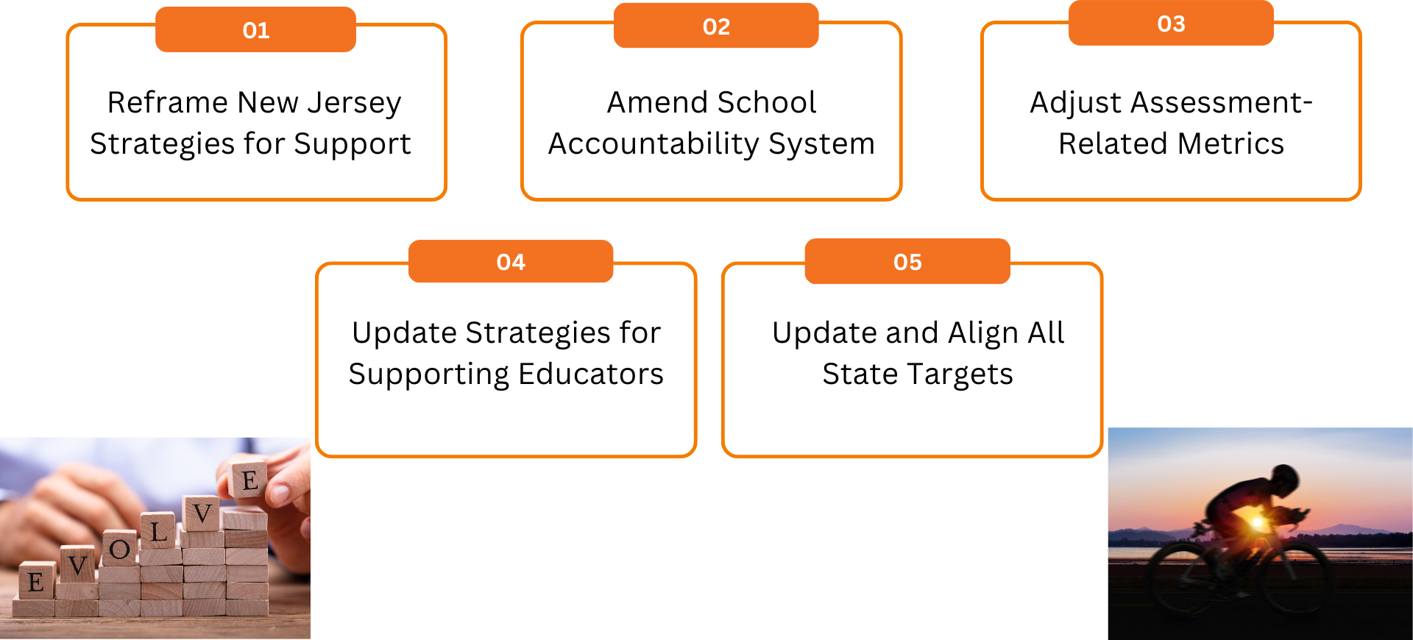
Revised State Plan Includes…
Notes:
To that end, over the next few months the NJODE will be seeking input on the these changes to ensure the NJDOE continually improves/evolves its systems of support.
This will serve as a draft for the new draft outline of our plan. Today you will hear how we are thinking about #1 from Stephanie Osgoodby and #4 from Pete Mazzagatti. Azan will propose that we explore/evolve a form of support that leverages some rules around #2.

Slide 33

ESSA Requirements
ESSA requires LEAs to fully engage in the school improvement process and collaborate with schools to implement appropriate evidence-based interventions and supports. ESSA also charges the SEA with supporting a continuous improvement framework for the SEA and the LEAs.
Continuous Improvement
Review & Approval of District Plans
Monitoring of State and District Plans
Differentiated Technical Assistance
Describe the SEA’s plan to improve SEA and LEA plans and implementation continuously.
All state education agencies must have a process for supporting the development of, reviewing, and approving of LEA plans.
All state education agencies must assess the quality of SEA and LEA implementation of strategies and progress toward meeting the desired program outcomes.
All state education agencies must provide differentiated technical assistance to LEAs and schools to support effective implementation of school improvement strategies.
Notes:
The Every Student Succeeds Act, or ESSA, was adopted in 2015 and attempted to alleviate some of the more controversial aspects of NCLB while retaining the favorable components.
ESSA also requires the SEA’s describe its plan to monitor both SEA and LEA implementation of the included programs to ensure compliance with statutory and regulatory requirements and articulate how the SEA will collect and use data and information to assess the quality of SEA and LEA implementation of strategies and progress toward meeting the desired program outcomes.

Slide 34
A Culture of Support
A System of Support and Continuous Improvement
Since 2017...
3 rounds of school identification
264 schools identified for either CSI, TSI, or ATSI support
180 schools exited status this past identification cycle
Identified schools receive intensive help including additional fiscal resources and coaching provided by the Office of Comprehensive Support.
The NJDOE works alongside our dedicated educators to continuously improve the quality of education provided to their students.
As we expect schools to do, the NJDOE analyzes student data and evolving research to craft strategic adjustments to ensure that we continue to hold all schools (and students) to high standards while working towards a climate of trust and support.
Notes:
Since the implementation of our state plan, we have had 3 successful rounds of school identification. We are currently serving 264 schools through individualized support structures and have seen 180 schools exit status during this past identification cycle, which is a remarkable achievement given the influence of the pandemic. The exceptional supports and coaching offered by the Office of Comprehensive Support, and the dedication and adaptability of our schools in the face of a changing educational landscape undoubtedly played a large role here.
Keeping our successes and lessons learned in mind, the educational landscape has seen some significant shifts since our state plan was implemented. In the spirit of the Every Student Succeeds Act, New Jersey has been hard at work analyzing data and crafting strategic adjustments to ensure that we continue to hold all schools (and students) to high standards while working towards a climate of trust and support.

Slide 35
Level III ESSA Supports
  Grant School Improvement Award
  Provide guidance and assistance in developing school improvement plans
  Facilitate progress monitoring of the annual school plan(s)
  Promote a growth mindset and continuous improvement
  Provide coaching to school and district leaders to support their growth as instructional leaders and enhance their capacity to coach
  Collaborate with district leaders to ensure that schools receive critical support and to identify and implement evidence-based instructional practices
  Support teachers’ professional learning based on internal data metrics
  Facilitate professional growth opportunities related to school and district improvement
  Provide guidance on the use of Federal funds related to school and district improvement
Provide NJDOE-sponsored programs, targeted technical assistance, and/or other opportunities related to school and district improvement
Notes:
Focus on continuous improvement process (think-plan-act-do) – strategy for using data – iterative, deliberate, collaborative
ESSA allows that states provide 5% of the total Title IA allocation for school improvement initiatives. The NJDOE was awarded more than $465 million in FY24 and SIA allocations in the same year were more than $30 million dollars in FY 24 and more than $177 million since 2017
More than 1500 meetings/engagements with superintendents, asst. superintendents, curriculum staff, principals, coaches, and other school leaders in FY 24
Socratic thinking seminar, data literacy workshops, instructional planning, questioning, feedback, collective efficacy,

Slide 36
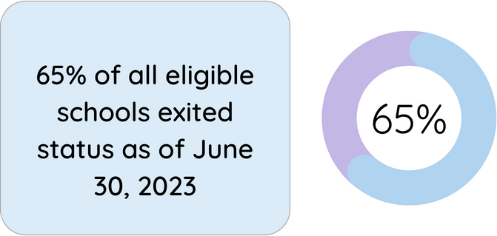
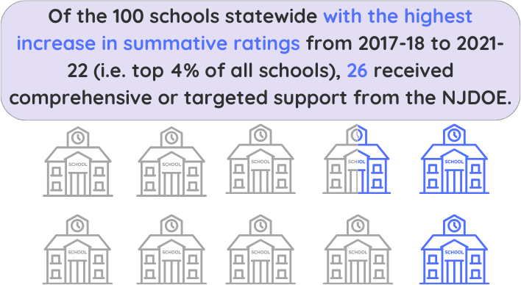
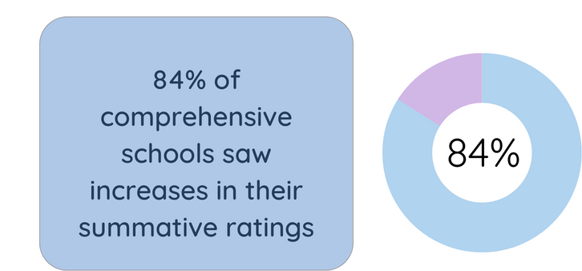
Success of Most Intensive ESSA Supports

Slide 37
ESSA Indicators & Requirements
All accountability indicators must allow for meaningful differentiation, be valid, reliable, comparable, and available statewide.
Academic Achievement
Academic Progress
Graduation Rate
Progress in English Language Proficiency
School Quality Student Success
For all public schools in the state, a measure of proficiency on the annual assessments required under ESSA.
For public elementary and secondary schools that are not high schools, a measure of student growth.
For public high schools in the state, measure the four-year adjusted cohort graduation rate; and at the state's discretion, the extended year cohort graduation rate.
For public schools in the state, measure progress in achieving English language proficiency, as defined by the state, within a state-determined timeline for all English learners.
For all public schools in the state, include not less than one indicator of school quality or student success.
Notes:
The Every Student Succeeds Act, or ESSA, was adopted in 2015 and attempted to alleviate some of the more controversial aspects of NCLB while retaining the favorable components. The result is a law that while still focused primarily on assessment outcomes, provided states with more autonomy in developing a system tailored to their needs.
New Jersey took this opportunity and conducted extensive stakeholder engagement and data review, resulting in a system focused on the closure of achievement gaps and the preparation of students for post-secondary success.
Under ESSA, states are required to identify schools for support and improvement using the following accountability indicator categories:
Academic Achievement
Academic Progress
Graduation Rate
Progress in English Language Proficiency, and
At least one measure of School Quality or Student Success
*Pause here for a second*
The indicators that a state selects must allow for meaningful differentiation (there needs to be enough variability across schools to make identification determinations), they must be valid, reliable, comparable, and available statewide.
In addition to these universal requirements, ESSA also specifies some additional – indicator specific criteria – such as for the Academic Achievement indicator which is required to be a measure of proficiency on the annual assessments required under the law.
*click*
This presentation will focus on two accountability measures;
Progress Towards English Language Proficiency, and
Academic Achievement.
Specifically, we will discuss ways in which we can enhance these indicators by applying specific adjustments to better capture schools that may need support. I will note that the proposals included in this presentation only relate to school accountability determinations and would not impact other reporting requirements or data usage.

Slide 38
Current Indicators
Grade Level Configuration
Category | Indicator | ES/MS | Mixed | HS
Academic Progress | ELA Growth (mSGP) | X | X | -
 | Math Growth (mSGP) | X | X | -
Academic Achievement | ELA Proficiency | X | X | X
 | Math Proficiency | X | X | X
Graduation Rate | Four-Year Graduation Rate | - | X | X
 | Five-Year Graduation Rate | - | X | X
ELP Progress | English Language Progress | X | X | X
School Quality/Student Success | Chronic Absenteeism | X | X | X
Notes:
The indicators that we use for each category are displayed on this slide along with an "X" that indicates whether that indicator is available or not for the three grade configurations that we groups schools into.
*click*
The four categories that I’ve highlighted here are the primary focus of the ESSA law. The School Quality/Student Success indicator (SQSS for short) is where states have the most latitude – a wide variety of measures can be included under this indicator category if it meets specific criteria requirements:
Allows for meaningful differentiation in school performance,
Is valid, reliable, comparable, and statewide (with the same indicator or indicators used for each grade span, as such term is determined by the State); and
May include one or more of the following: Student engagement, educator equity, student access to and completion of advanced coursework, postsecondary readiness, school climate and safety, or any other indicator the State chooses that meets the requirements above.

Slide 39
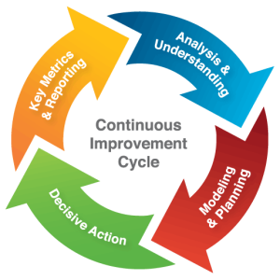
ELP - Continuous Improvement
Holding true to its commitment of continuous improvement, NJDOE:
Has partnered with the Regional Education Lab (REL) to examine successes and areas of improvement for the ELP indicator.
Regularly conducts literature reviews examining how multiple factors, such as a student's age, starting ELP performance level, and ML program type influence a student’s progress in English language proficiency.
Monitors student performance trends prior to, during, and coming out of the pandemic to better understand where adjustments and supports may be needed.
This Photo by Unknown Author is licensed under CC BY-SA
Notes:
And so, before going into an examination of growth trends, I did want to pause and highlight some of the work that we’ve been doing to better understand and improve upon our accountability system.
Holding true to our commitment of continuous improvement, NJDOE partnered with the Regional Education Lab (REL) to examine successes and areas of improvement for the ELP indicator.
In addition to this partnership, NJDOE has continued conducting literature reviews which recommend an examination of how multiple factors, such as a student's age, starting ELP performance level, and the Language Instruction Education Program, or LIEP, that a student is enrolled in influence a student’s progress in English language proficiency.
NJDOE continues to monitor student performance trends prior to, during, and coming out of the pandemic to better understand where adjustments and supports may be needed.
If asked:
What do the trends look like? Are they different during/coming out of the pandemic?
Overall from preliminary analysis, trends appear similar during/coming out of the pandemic, more growth is observed early on and tends to slow over time. The magnitude of growth is depressed however. Additional analysis will be conducted once the most recent ACCESS for ELLs data has been cleaned

Slide 40
New Jersey Department of Education
@NewJerseyDOE
@newjerseydoe
Thank You!
New Jersey Department of Education
New Jersey Department of Education
@newjerseydoe

Slide 42
ESSA Implementation

Slide 43
Title I, Part D
Ms. Francine Stromberg, Coordinator
Office of Fiscal & Data Services

Slide 44
Program Goals
Improve educational services for children and youth in local, tribal, and State institutions who are neglected or delinquent children and youth, so that they have the opportunity to meet the same challenging State academic standards that all children in the State are expected to meet.
Provide these children and youth with services to successfully transition to further schooling or employment.
Prevent at-risk youth from dropping out of school, and to provide students who have dropped out, and children and youth returning from correctional facilities or institutions for neglected or delinquent children and youth, with a support system to ensure their continued education and the involvement of their families and communities.

Slide 45
Use of Funds – Subpart 1
  Programs and projects consistent with the State plan.
  Programs and projects that provide participants with the knowledge and skills needed to successfully transition to post-secondary school, career and technical education, further education, or employment.

Slide 46
Use of Funds – Subpart 2
Programs that serve children and youth returning to local schools from correctional facilities.
Dropout prevention programs.
Coordination of health and social services if there is a likelihood that the service, including day care, drug and alcohol counseling, mental health services, will help with individuals completing their education.
Special programs to meet unique academic needs of the children, including career and technical education, special education, career counseling, assistance in securing student loans or grants for post-secondary education.
Programs providing mentoring and peer mediation.

Slide 47
FY23-24 TIPD Allocations
TIPD, Subpart 1 | Allocation
Department of Corrections (DOC) | $168,609
Department of Children and Families (DCF) | $1,014,374
Juvenile Justice Commission (JJC) and Juvenile Detention Centers (JDC) | $380,730

Slide 48
FY23-24 TIPD Allocations (2 of 2)
TIPD, Subpart 2 | Allocation
Bergen County Juvenile Detention Center | $ 23,061
Camden County Juvenile Detention Center | $161,427
Essex County Juvenile Detention Center | $376,664
Middlesex County Juvenile Detention Center | $204,987
Morris County Juvenile Detention Center | $46,122
Ocean County Juvenile Detention Center | $48,684
Notes:
Total Allocations for TIPD Subpart 2: $860,946
Formula based on Neglected and Delinquent count collected October 2022

Slide 49
FY23 Monitoring and Follow-Up Monitoring Review (1 of 3)
Department of Children and Families - Completed
Monitoring
      Burlington Campus
      Cumberland Campus
      Ocean Campus
Follow-Up Monitoring
      Atlantic Campus
      Cape May Campus
      Monmouth Campus

Slide 50
FY23 Monitoring and Follow-Up Monitoring Review (2 of 3)
Department of Corrections
Follow-Up Monitoring - Completed
      Garden State Correctional Facility

Slide 51
FY23 Monitoring and Follow-Up Monitoring Review (3 of 3)
Juvenile Justice Commission – Partially Completed
Monitoring
    DOVES Program (awaiting confirmation of rescheduled date)
    Southern Residential Community Home
    Bergen County Juvenile Detention Center
    Ocean County Juvenile Detention Center
Follow-Up Monitoring
    Pinelands Residential Community Home
    Juvenile Medium Secure Facility

Slide 52
New Jersey Department of Education
@NewJerseyDOE
@newjerseydoe
Thank You!
New Jersey Department of Education
New Jersey Department of Education
@newjerseydoe

Slide 54
Fall 2023 Graduation and
Accountability Report Update
Ms. Jessica Merville, Director
Mr. John Iko, Data Analysis
Office of Performance Management

Slide 55

2023 Graduation Rate Updates
September 18, 2023
Districts can view preliminary graduation rates in NJ SMART
Graduation Appeals period opens
September 13, 2023
NJDOE Broadcast with details about Graduation Appeals process and links to resources
October 6, 2023
Deadline for districts to submit graduation appeals in NJ SMART by 5 p.m.
Mid/Late November 2023
Districts can view final 2023 graduation rates in NJ SMART
August 31, 2023
Official NJ SMART Graduation Snapshot
Graduation Appeals Process in Progress

Slide 56
2022-2023 ESSA Accountability Process
New Jersey’s approved ESSA state plan outlines that the NJDOE will identify schools in the following categories for support and improvement:
Category | Description | Frequency
Comprehensive Support and Improvement (CSI) | Overall Low Performing: Title I schools with a summative score in the bottom 5% of Title I schools Low Graduation Rate: Any high school with a federal 4-year graduation rate of 67% of less Chronically Low Performing: Title I schools identified for additional targeted support and improvement for three or more consecutive years. | Every 3 years*
Additional Targeted Support and Improvement (ATSI) | Schools with at least one student group with a summative score that would be in the bottom 5% of Title I schools. | Every 3 years
Targeted Support and Improvement (TSI) | Schools with at least one student group that missed annual targets and performed below the state average for all available indicators for two years in a row. | Annually

Slide 57
Fall 2023 ESSA School Identification
The NJDOE received approval through the COVID-19 State Plan Addendum for a one-time change to the identification timeline, which allows the NJDOE to identify schools for CSI and ATSI status in both fall 2022 and fall 2023, instead of every three years.
As a result, the NJDOE will be identifying schools for CSI, ATSI, TSI status in fall 2023 based on data from the 2022-2023 school year.
Additionally, all schools currently identified for CSI, ATSI, and TSI status will be reviewed to determine if they meet exit criteria to exit status in June 2024.

Slide 58
2022-2023 ESSA Indicator Updates
Academic Progress
An alternate measure of academic progress, Relative School Improvement Measure, was used for the 2021-2022 school year because prior year assessment results were not available.
Graduation Rates
Cohort 2022 four-year and Cohort 2021 five-year federal graduation rates will be used for the fall 2023 accountability process.
Median student growth percentiles (mSGPs) will be used to measure academic progress for the fall 2023 ESSA accountability process.
Students with disabilities who did not meet state course, local attendance, or state graduation assessment requirements will not be included as graduates in the federal graduation rate.

Slide 59
ESSA Accountability Profiles
The NJDOE will be releasing the 2023 ESSA Accountability Profiles in early November.
Districts can use the profiles to review data for all indicators at the district, school, and student group and see the status in meeting annual targets or standards.
Along with the profiles, the NJDOE will also be sharing student-level data and resources to support districts’ review of the profiles in NJDOE Homeroom.

Slide 60
New Jersey Department of Education
@NewJerseyDOE
@newjerseydoe
Thank You!
New Jersey Department of Education
New Jersey Department of Education
@newjerseydoe

Slide 62
Nita M. Lowery 21st Century
Community Learning Centers
Dr. Shawanda Beale,
Assistant Division Director
Office of Student Support Services
Division of Educational Services

Slide 63
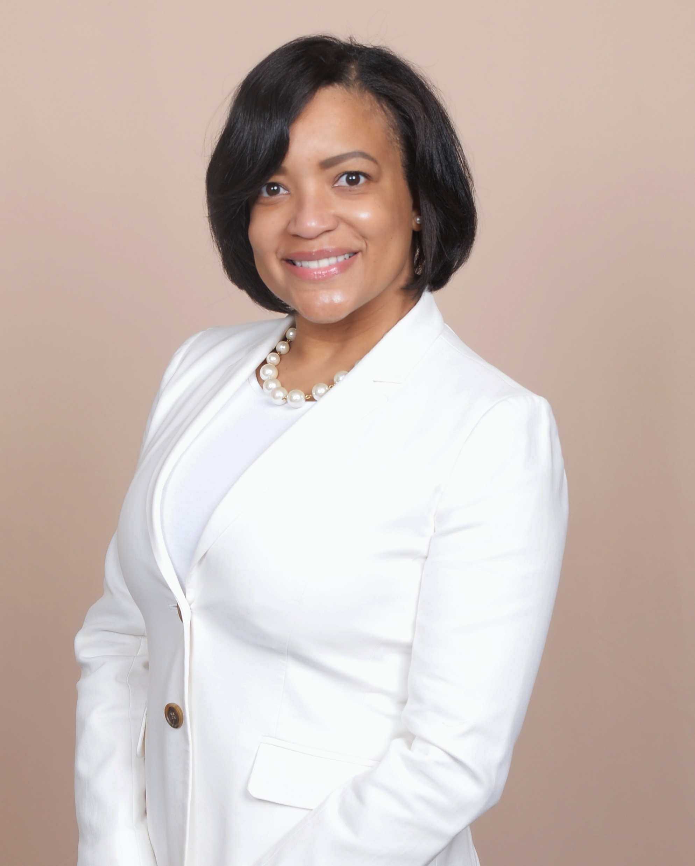

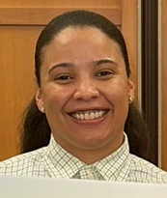


Meet the Team
Dr. Shawanda Beale
State Coordinator
Tamika Chester, M.S.
Program Officer
Shantel Brown, M.H.S.
Program Officer
Jeannie Weaver, Ed.S., NCSP
Program Officer
Laura Kale, M.S.
Pars 21

Slide 64

Overview
The Nita M. Lowey 21st Century Community Learning Centers (21st CCLC), a federally funded program, provides approximately $28 million to the New Jersey Department of Education (NJDOE) to support out-of-school time programs which include before-school, after-school, or summer enrichment. Under Title IV, Part B of the Every Student Succeeds Act (ESSA), the purpose of the 21st CCLC program is to provide opportunities for communities to establish or expand activities in community learning centers that:
Increase academic enrichment, including providing tutorial services to help students, particularly students who attend low-performing schools, to meet the challenging State academic standards;
Offer students a broad array of additional services, programs, and activities, such as nutrition and health education programs, drug and violence prevention programs, counseling programs, and others that are designed to reinforce and complement the regular academic program of participating students; and
Offer families of students served by community learning centers opportunities for active and meaningful engagement in their children’s education, including opportunities for literacy and related educational development.
Notes:
The Nita M. Lowey 21st Century Community Learning Centers (21st CCLC), a federally funded program, provides approximately $28 million to the New Jersey Department of Education (NJDOE) to support out-of-school time programs which include before-school, after-school, or summer enrichment.
the purpose of the 21st CCLC program is to provide opportunities for communities to establish or expand activities in community learning centers that:
Increase academic enrichment
Offer students additional services such as nutrition and health education programs, drug and violence prevention programs, counseling programs, and others that are designed to support their regular academic program
Offer families of the students served support by creating opportunities for active and meaningful engagement in their children’s education

Slide 65

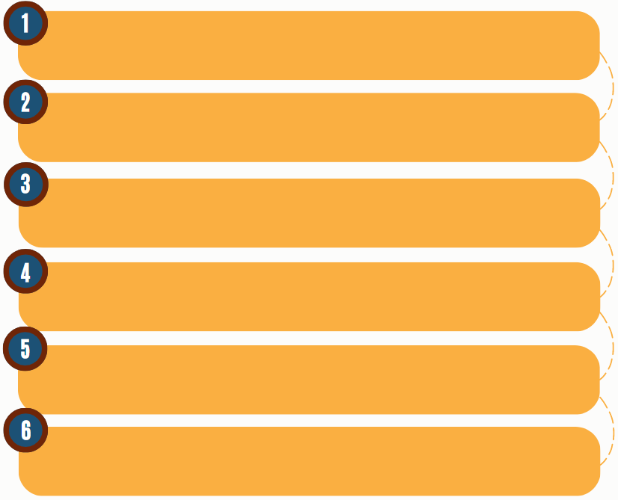
Program Expectations
  Nita M. Lowey 21st Century Community Learning Centers (21st CCLC) Programs Provide:
    An engaging and interactive environment for students, families, and staff.
    Innovative and hands-on activities.
    Collaborative relationships.
    Safe and welcoming environment.
    Youth-centered programming.
Supports to school-day learning.
Notes:
The expectation for each of the 21st Century programs is that they will provide:

Slide 66

Eligibility Requirements
This grant is a limited, competitive grant program open to all New Jersey public or private agencies, which includes:
  Local education agencies (LEAs), including charter schools, educational service commissions, jointure commissions, and special services school districts;
  Nonpublic schools;
  Community-based organizations;
  City or county government agencies;
  Faith-based organizations;
  Institutions of higher education;
  For-profit agencies;
  Indian tribes or tribal organizations (as such terms are defined in section 4 of the Indian Self-Determination and Education Act: 25 U.S.C. 450b); and
  Consortia of two or more such agencies, organizations, or entities.
  Eligible agencies must serve students in any grade 3 through 12; and who primarily attend schools implementing comprehensive or targeted support and improvement activities; or
  Students attending other schools determined by the LEA to need intervention and support; and families of such students.
Notes:
This grant is a limited, competitive grant program open to all New Jersey public or private agencies.
Applicants must propose to serve students in any grade 3 through 12 who attend:
schools implementing comprehensive or targeted support and improvement activities; or
schools eligible for schoolwide programs; or
schools determined by the LEA to need intervention and support or
schools with a high percentage of students from low-income families.
Schools that serve a high percentage of low-income families will be defined as those schools that have a minimum of 30% of its student population defined as low-income. Low-income families are defined as those families whose children are eligible for free lunch and/or free milk as defined in the Application for State School Aid (ASSA).

Slide 67
Current Data for 23-24 Grantees
68 Total Grantees

Slide 68


Braiding Funding
New Jersey School Age Child-Care Coalition has developed a free, downloadable toolkit with information needed to assist school district leaders to partner with quality afterschool providers to create afterschool, out-of-school time (OST), and summer programs using ESSER funds.
The toolkit includes:
  How to Get Started Checklist: Resources to help schools and community partners develop sustainable, evidence-based programs, including a cost-per-student calculator.
  Boosting Academics: Best practices for tutoring programs.
  Engaging Students: Resources for creative, experiential, and project-based learning.
  School Culture Recovery: Resources for social-emotional learning, mental health, and trauma-informed practice.
  Learning Year-Round: Best practices for investing in summer programming.
  Technical Assistance: How NJSACC can help you.
  ARP ESSER Background: Funding timeline and NJ requirements.
Notes:
Through this grant, we are partnered with New Jersey School-Age Child Care Coalition or NJSACC. Our partners have created a resource for our grantees to encourage the use of braided funding to support the creation of afterschool, out of school time, and summer programs using ESSER funds. If you would like to check out the toolkit, I put the QR code that will link directly to the pamphlet.

Slide 69
New Jersey Department of Education
@NewJerseyDOE
@newjerseydoe
Thank You!
New Jersey Department of Education
New Jersey Department of Education
@newjerseydoe

Slide 71
Federal Grants Update
Office of Grants Management
Division of Business and Finance Services
Jill Dobrowansky
September 2023

Slide 72
Elementary & Secondary Education Act (ESEA)
FY23 Final Expenditure Reports
  Released 8/18/2023
  Due no later than 10/20/2023
  Offering Technical Assistance & Office Hours
FY24 Original Application
  93% on-time submission rate

Slide 73
CRRSA-ESSER II
Final Expenditure Reports
  Released 8/14/2023
  Due no later than 10/20/2023
  Offering Technical Assistance & Office Hours
  Late Liquidation
    Guidelines Developed & Communicated via Broadcast Memo
    Preliminary Application – NJ Homeroom
    Fiscal Application - EWEG

Slide 74
ARP-ESSER III
Project Period ends 9/30/2024.
Amendments and Reimbursement Requests remain open until 2024.
Collaborate with NJDOE Divisions to support LEAs in spending down funds.

Slide 75
Office of Grants Management
Contact Information
EWEG Help Desk
ESSER Help Desk

Slide 76
New Jersey Department of Education
@NewJerseyDOE
@newjerseydoe
Thank You!
New Jersey Department of Education
New Jersey Department of Education
@newjerseydoe

Slide 78
New Jersey Department of Education
@NewJerseyDOE
@newjerseydoe
Thank You!
Remember to mark you calendar for the next ACFFP meeting Scheduled for
Friday, January 26, 2023
New Jersey Department of Education
New Jersey Department of Education
@newjerseydoe

